Slide 1
SWE1018
Human Computer Interaction

Slide 2
Text Book
Gerard Jounghyun Kim, Human Computer Interaction – Fundamentals and Practice, – CRC press, 2015.
Reference Books
Julie A. Jacko, The Human–Computer Interaction Handbook: Fundamentals, Evolving Technologies, and Emerging Applications, 3rd Edition, CRC Press (Taylor & Francis Group) 2012.
Ben Shneiderman, Catherine Plaisant, Maxine Cohen, Steven Jacobs, Designing the User Interface: Strategies for Effective Human Computer Interaction, 5th Edition, Pearson, 2009.
Alan Dix, Janet E. Finlay, Gregory D. Abowd, Russell Beale, Human - Computer Interaction, 3rd Edition, Pearson, 2003.

Slide 3
Module 1
Human Computer Interaction and its frameworks, Principles of HCI, Types of Interaction styles

Slide 4
• Human Computer Interaction
– USA: Computer-Human Interaction (CHI)
– USA: Man-Machine Interface (MMI)
• Human Computer Interface
• is the study of the interaction between people,
computers and tasks involves the development and application of principals, guidelines and methods to support the design and evaluation of interactive systems

Slide 5
HCI (human-computer interaction) is the study of how people interact with computers and to what extent computers are or are not developed for successful interaction with human beings. A significant number of major corporations and academic institutions now study HCI.

Slide 6
Cognitive
Psychology
Social
Organizational
Psychology
Linguistics
Anthropology
Ergonomics
&
Human
Factor
HCI
Philosophy
Design
Computer
Science
Engineering
Artificial
Intelligence

Slide 7
Disciplines
Psychology
– understanding the user
– modelling the user
• Sociology
– groupware
• Art
– aesthetic appeal
• Design
– user interface layout

Slide 8
• Engineering/Computer Science
– faster machines
– faster systems
– means of building better interfaces
• Linguistics
– language for commands
• Philosophy
– creating consistency

Slide 9
Physiology
– physical capabilities
• Anthropology
– user body shape
• Ergonomics
– equipment design
• AI
– help facilities
– modelling the user

Slide 10
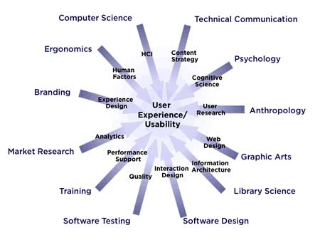

Slide 11
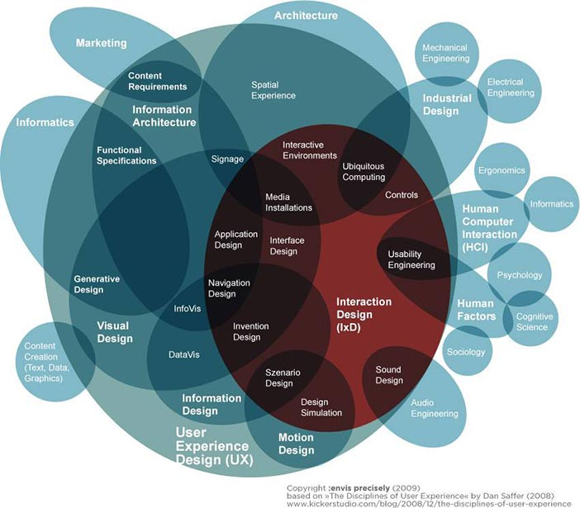

Slide 12
Main Factors
1.Organizational Factors
– training, job design, politics, roles, work organisation
2. Environmental Factors
– noise, heating, lighting, ventilation
3. Health and Safety Factors
– stress, headaches, musculo-skeletal disorders
4. The User
– motivation, enjoyment, satisfaction, experience level
5. Comfort Factors
– seating, equipment layout

Slide 13
6. User Interface
– input devices, output devices, dialogue structures, use of colour,
icons, commands, graphics, natural language, 3D, multimedia
7. Task Factors
– easy, complex, novel, task allocation, repetitive, monitoring, skills
8. Constraints
– costs, timescales, budgets, staff, equipment, building structure
9. System Functionality
– hardware, software, applications
10. Productivity Factors
– increase: output, quality
– decrease: costs, errors, labour requirements, production time

Slide 14
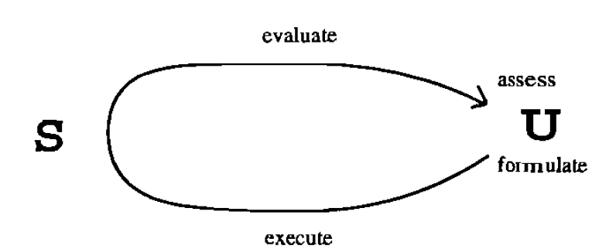
A Framework for Discussing Interaction
Four phases of interaction between User (U) and System

Slide 15
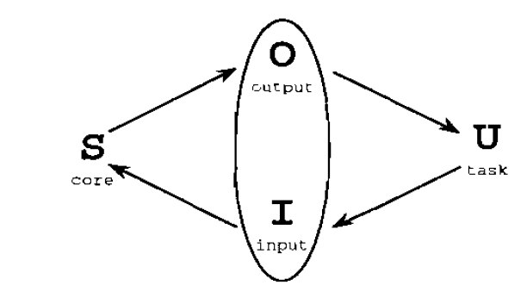
The general interaction framework

Slide 16
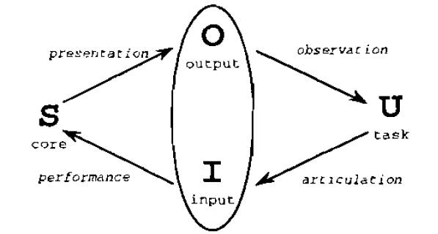
Translations between components

Slide 17
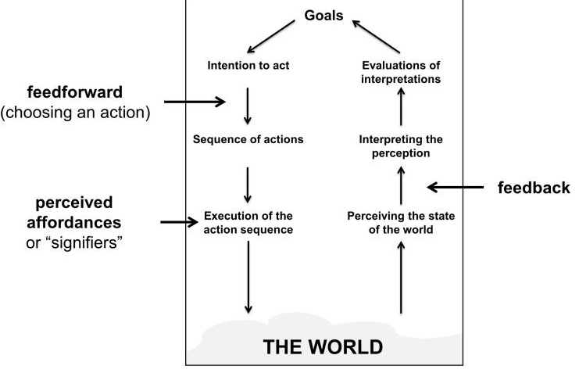
Frame work of HCI

Slide 18
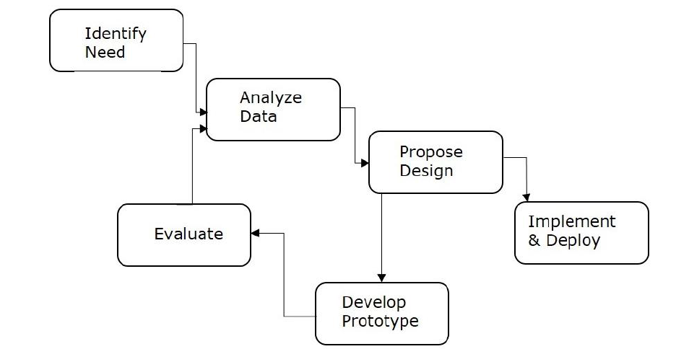

Slide 19
Interaction Frameworks
Why have a framework?
Allows contextualisation, presents a global view
Donald Norman’s Interaction framework
• user establishes the goal
• formulates intention
• specifies actions at interface
• executes action
• perceives system state
• interprets system state
• evaluates system state with respect to goal

Slide 20
Some systems are harder to use than others
• Gulf of Execution - user’s formulation of actions may be different to those actions allowed by the system
• Gulf of Evaluation - user’s expectation of the
changed system state may be different to the actual
presentation of this state
Norman’s model concentrates on user’s view of theinterface only

Slide 21
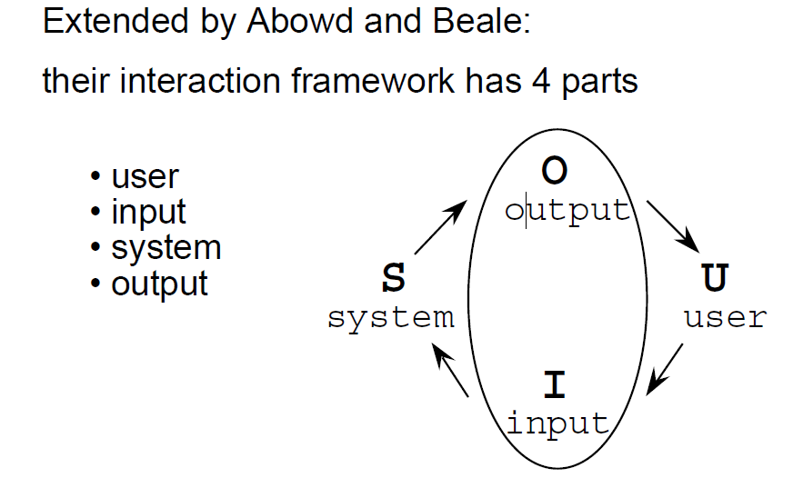

Slide 22
Ergonomics
Study of the physical characteristics of interaction.
Also known as human factors.
Considers things such as
• arrangement of controls and displays
e.g. controls grouped according to function, or
frequency of use, or sequentially
• surrounding environment
e.g. seating arrangements adaptable to cope
with all sizes of user
• health issues
e.g. physical position, environmental
conditions (temperature, humidity), lighting,
noise
• use of colour
e.g. use of red for warning, green for okay,
awareness of colour-blindness
etc.

Slide 23
Principles of HCI

Slide 24
Despite its importance, good HCI design is generally difficult, mainly because it is a multiobjective task that involves simultaneous consider-ation of many things, such as the types of users, characteristics of the tasks, capabilities and cost of the devices, lack of objective or exact quan-titative evaluation measures, and changing technologies, to name just a few.
A considerable knowledge in many different fields is required. Over the relatively young history of HCI, researchers and developers in the field have accumulated and established basic principles for good HCI design in hopes of achieving some of the main objectives (as a whole) that were laid out in the previous section. These HCI principles are general, fundamental, and commonsensical, applicable to almost any HCI design situation. Here, we provide a short review of the main HCI principles.

Slide 25
Principles of HCI
Know Thy User”
Understand the Task
Reduce Memory Load
Strive for Consistency
Remind Users and Refresh Their Memory
Prevent Errors/Reversal of Action
Naturalness

Slide 26
Know Thy User
The foremost creed in HCI is to devise interaction and interfaces around the target users.
“Know thy user,” so-called user-centered design approach has become a buzzword only in recent years.
This principle simply states that the interaction and interface should cater to the needs and capabilities of the target user of the system in design.

Slide 27
Consider a situation where a developer is working to change an inter-face, supposedly to achieve higher usability. However, we might need to remember that while young adults are extremely adept at and open to adopting new interfaces, older generations are much less so
If a direct field study is not feasible, an experienced and humble HCI designer will at least try to leverage the vast knowledge available from cognitive psychology, ergonomics, and anthropomorphic data to assess the capa-bilities and characteristics of the target user group.

Slide 28
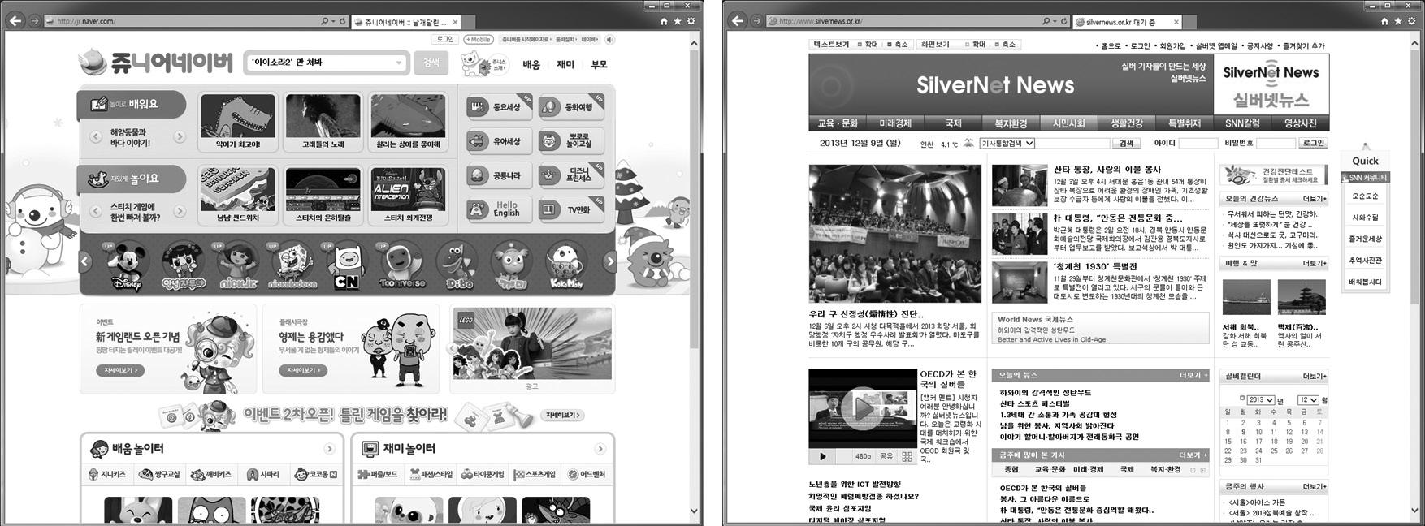
Examples of user-centered designs of web pages for (a) kids (courtesy of Junior Naver and (b) the elderly (courtesy of SilverNet News,

Slide 29
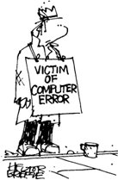
Traditional approaches to system development
Is concerned with producing software, software specification, maintainability, and testing
Generally considers the interface to be just another software component.

Slide 30
Example of traditional approach
Requirements
specification
Analysis
Design
Implementation
The waterfall model
Testing
Operation and
maintenance

Slide 31
Introduction to User Centered approach
This approach normally involves a number of key activities throughout the development of the software including:
Involving users
Obtaining their feedback on the design
Providing prototypes for system evaluation and re-design in light of user feedback and comments.

Slide 32
User Centered approach
Real users involved at each step of the process
Find out about the users before requirement specification
Design and implementation
Review (usability test) with the users

Slide 33
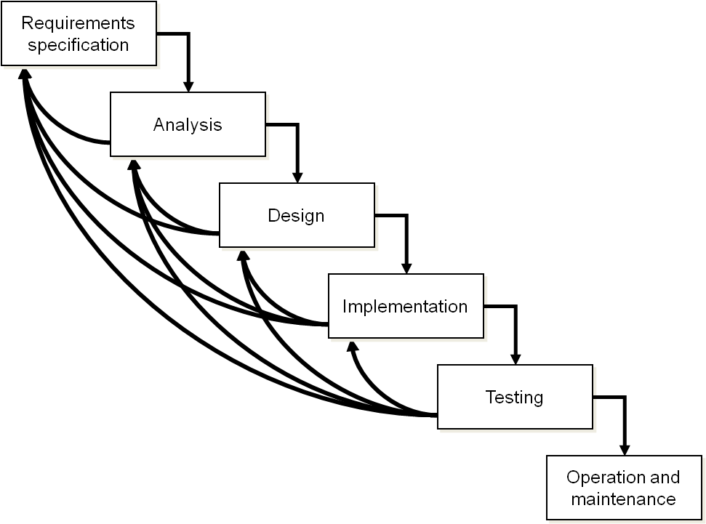

The life cycle for interactive systems
cannot assume a linear
sequence of activities
as in the waterfall model
lots of feedback!
user needs

Slide 34
User Centered Development
Data Collection
Data Analysis
Prototyping
Design
Evaluation

Slide 35
1. Data Collection
Data recording
  Using media
Interviews
  Stakeholder interviews
  Subject Matter Expert interviews
  User and customer interviews
Questionnaires
  Surveys, product reviews
Literature review
  Studying existing systems

Slide 36
2. Data Analysis
Requirement analysis
  Formal specifications of the system
User analysis
  Identifying and understanding the user
Task analysis
  Steps user take to accomplish this task
Functional analysis
  Functions that system perform to help the users carry out their task

Slide 37
3. Prototyping
Advantages of Prototyping:
Users are actively involved in the development
It provides a better system to users
The users get a better understanding of the system being developed.
Errors can be detected much earlier
Quicker user feedback is available leading to better solutions

Slide 38
4. Design
Goals
  Achieving goals
Users and systems
  Understanding the raw materials: computer and human
Limitations
  Accepting limitations of humans and of design

Slide 39
Understand the Task
The term task refers to the job to be accomplished by the user through the use of the interactive system
Different users will have different mental models of the task at hand, and this must be reflected in the structure of the interface to simplify implementation for all users
Example: Take the subtask (for a larger application) for “changing the Wi-Fi connec-tion access point” for a smartphone
task/interaction model may sometimes be developed based solely on the general human capacity.

Slide 40
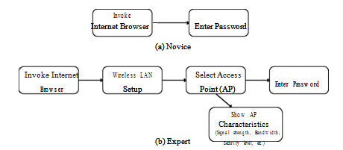

Slide 41
Reduce Memory Load
Designing interaction with as little memory load as possible is a principle that also has a theoretical basis
The capacity of the human’s short-term memory (STM) is about 5–9 chunks of information (or items meaning-ful with respect to the task), famously known as the “magic number”

Slide 42
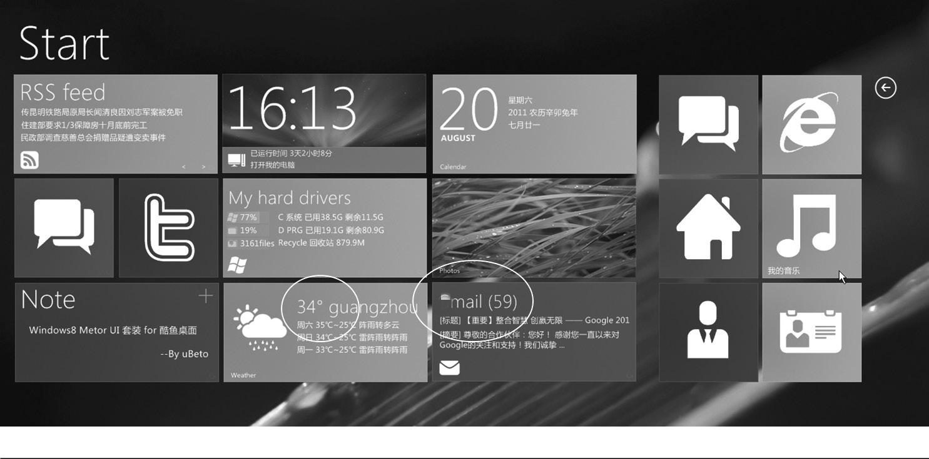
Interfaces designed for minimal short-term memory

Slide 43
Strive for Consistency
the user is likely to get confused and exhibit erroneous responses if the same subtask is involved, at different times, for different interaction steps or interface methods
Aside from being able to remember what to do, consistency and familiarity also lead to higher acceptability and preference

Slide 44
Remind Users and Refresh Their Memory
Any significant task will involve the use of memory, so another good strategy is to employ interfaces that give continuous reminders of important information and thereby refresh the user’s memory
Even a single task may proceed in different contextual spans. For instance, in an online shopping application, one might cycle through the entry of different types of information: item selection, delivery options, address, credit card number, number of items, etc.
To maintain the user’s awareness of the situation and further elicit correct responses, informative, momentary, or continuous feedback will refresh the user’s memory and help the user complete the task easily.
One particular type of informative feedback (aside from the cur-rent status) is the reaffirmation of the user action to signal the closure of a larger process

Slide 45
Prevent Errors/Reversal of Action
error-free operation is equally important
the interaction and interface should be designed to avoid confusion and mental overload
Inactive menu items are good examples of such a technique. Also, having the system require the user to choose from possibilities (e.g., menu system)
Despite employing some of the principles and techniques described here, there is always a chance that the user will make mistakes

Slide 46
Naturalness
“natural” interaction and interfaces.
Naturalness refers to a trait that is reflective of various oper-ations in our everyday life. For instance, a perfect HCI may one day be realized when a natural language–based conversational interface is possible
A natural or metaphoric interface (assuming that the metaphor is not contrived) will also have affordance, a property (or additional cues) that appeals to our innate perception and cognition, thus making it so intuitive that the interface would require almost no learning

Slide 47
Interaction Styles
Command Line
• Menu-Based Interface
• Form Fill-In
• Question and Answer
• Direct Manipulation
• Metaphors
• Web Navigation
• Three-Dimensional Environments
• Zoomable Interface
• Natural Language

Slide 48

Interaction Styles - Command Line
• Command-line interfaces are fast and powerful.
- Many commands are abbreviated
• quick and efficient
- Commands can be applied to many objects
simultaneously
• fast input
- Some commands have multiple parameters that can
be set and altered
• precise and flexible

Slide 49
Interaction Styles - Command Line
• Command Line and the EECA
- Intention formation, specification of the action, and the
execution stages are complex
- Requires a rather accurate mental model of the computer’s
internal processing
• Command Line and the Interaction Framework
- Translating the user’s task language into the input language
requires knowledge of the core language
- The output language can be confusing for inexperienced
users - there is very little feedback

Slide 50
Interaction Styles - Command Line
• Command Line and Articulatory Distance
- Articulatory distance is large because we are
presented with only the command prompt - no
indication of functionality

Slide 51
Interaction Styles - Command Line
• Advantages of command-line interfaces:
- Suitable for repetitive tasks
- Advantageous for expert users
- Offer direct access to system functionality
- Efficient and powerful
- Not encumbered with graphic controls
• Low visual load
• Not taxing on system resources

Slide 52
Interaction Styles - Command Line
• Disadvantages of command-line interfaces:
- Low command retention
- Steep learning curve
- High error rates
- Heavy reliance on memory
- Frustrating for novice users

Slide 53
Interaction Styles - Menu-Based Interface
• Menu-driven interfaces present users with
sequential hierarchal menus that offer lists of
functions.
- Textual: key-in number of option
- Graphical: use arrow keys or pointing device

Slide 54
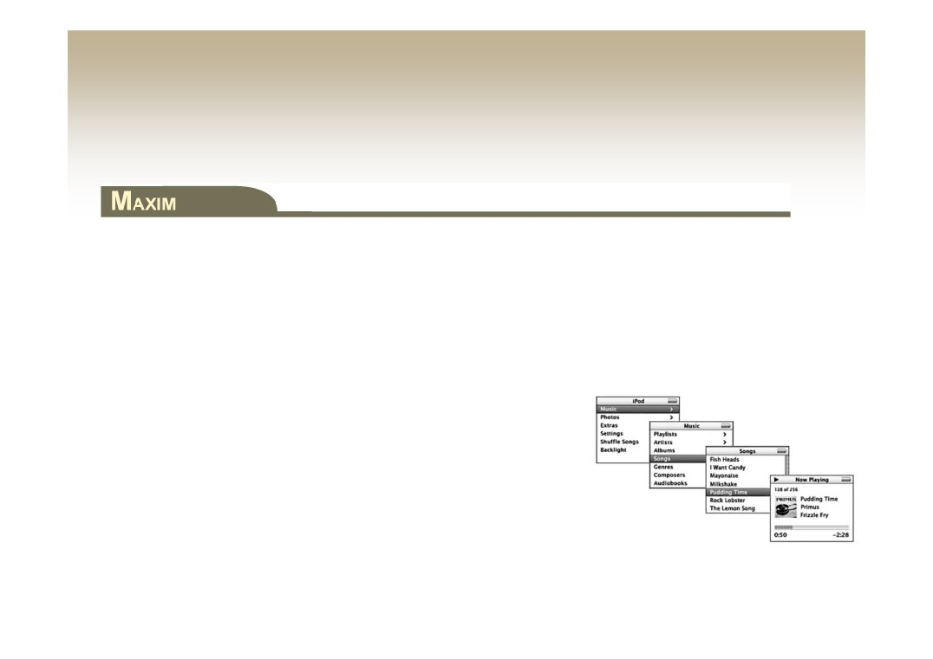
Interaction Styles - Menu-Based Interface
Menus are based on recognition as opposed to recall
• No need to remember commands
• Users search from a list of possible choices
• List provides constraints
• Appropriate for small screens (iPod)

Slide 55
Interaction Styles - Menu-Based Interface
• Menu-based interfaces and the EEAC
- Menu constraints can help the user to form the proper
intentions and specify the proper action sequence
- Provide a context to evaluate the output language

Slide 56
Interaction Styles - Menu-Based Interface
• Menu-based interfaces and :
- Articulatory Distance
• Menu options create small articulatory distance
- Mental Models
• Menu construction has a direct impact on user’s mental
model
- Affordances
• Menu elements present affordances

Slide 57
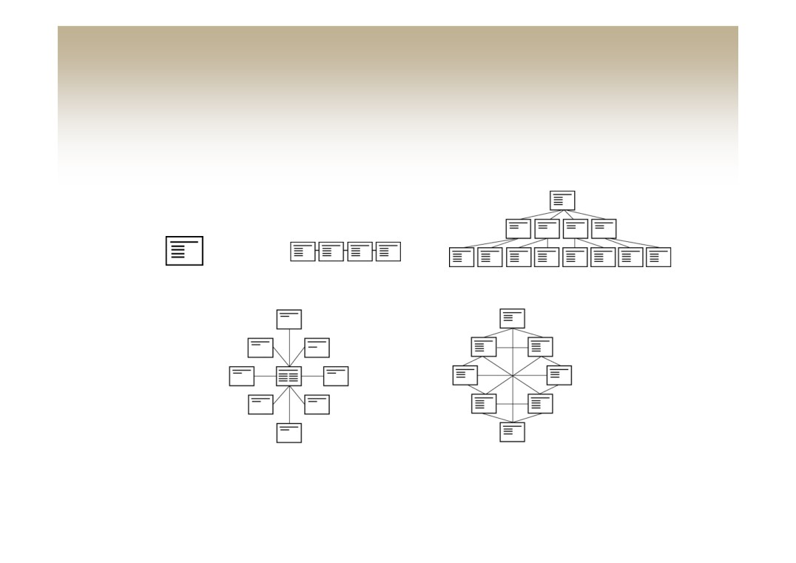
Interaction Styles - Menu-Based Interface
• Most menus are a variation on a few basic categories:
Single
Sequential
Hierarchal
Star network
Web network

Slide 58
Interaction Styles - Menu-Based Interface
• Advantages of menu-based interfaces:
- Low memory requirements
- Self-explanatory
- Easy to undo errors
- Appropriate for beginners
• Disadvantages of menu-based interfaces:
- Rigid and inflexible navigation
- Inefficient for large menu navigation
- Inefficient use of screen real estate
- Slow for expert users

Slide 59
Interaction Styles - Form Fill-In
• Similar to menu interfaces - present screens of
information
• Different than menu interfaces - used to capture
information and proceed linearly not to navigate a
hierarchical structure

Slide 60

Interaction Styles - Form Fill-In
Always inform the user about the length of paged forms and where
they are within the structure
• Forms can be presented using
- Single scrolling screens
- Multiple linked pages
• Form elements must be grouped logically
• Include “You Are Here” indications

Slide 61

Interaction Styles - Form Fill-In
Form elements must be unambiguously labeled to increase data
integrity
• Users must understand what data is required and what
format should be used
- Date information formats
1/29/2005, 29/1/2005, or January 29, 2005?

Slide 62
Interaction Styles - Form Fill-In
• Advantages of form fill-in interfaces:
- Low memory requirements
- Self-explanatory
- Can gather a great deal of information in little space
- Present a context for input information
• Disadvantages of form fill-in interfaces:
- Require valid input in valid format
- Require familiarity with interface controls
- Can be tedious to correct mistakes

Slide 63

Interaction Styles - Question and Answer
• Question and answer interfaces are also called wizards.
• They are restricting for expert users
• They are easy for novice users
- However, they may not know the required information
Users must be able to cancel a menu without affecting the state of
the computer

Slide 64
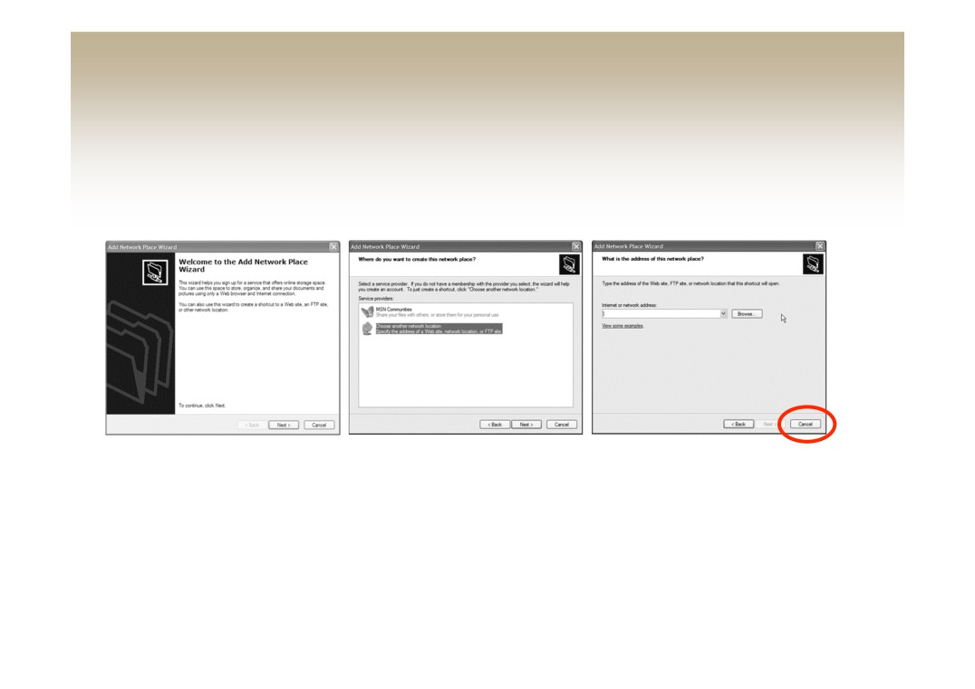
Interaction Styles - Question and Answer
• Microsoft Add Network Place Wizard
(a) Add Network Place wizard. (b) Select a service provider. (c) Address of the network place.

Slide 65
Interaction Styles - Question and Answer
• Advantages of question and answer interfaces:
- Low memory requirements
- Self-explanatory
- Simple linear presentation
- Easy for beginners
• Disadvantages of question and answer interfaces:
- Require valid input supplied by user
- Require familiarity with interface controls
- Can be tedious to correct mistakes

Slide 66
Interaction Styles - Direct Manipulation
• Ben Shneiderman (1982)
- Continuous representations of the objects and actions
of interest with meaningful visual metaphors.
- Physical actions or presses of labeled buttons instead
of complex syntax.
- Rapid, incremental, reversible actions whose effects
on the objects of interest are visible immediately.

Slide 67
Interaction Styles - Direct Manipulation
• Three phases in Direct Manipulation - Cooper,
Reimann (2003)
- Free Phase—How the screen looks before any user
actions
- Captive Phase—How the screen looks during a user
action (click, click-drag, etc.)
- Termination Phase—How the screen looks after a
user action

Slide 68
Interaction Styles - Direct Manipulation
• Direct Manipulation and the EEAC
- The range of possible intentions is consistently wide
- Users usually have multiple options for specifying
action sequences
• Can be overwhelming of novice users
- Provide multiple ways of executing action sequences

Slide 69
Interaction Styles - Direct Manipulation
• Advantages of direct manipulation interfaces:
- Easy to learn
- Low memory requirements
- Easy to undo
- Immediate feedback to user actions
- Enables user to use spatial cues
- Easy for beginners
• Disadvantages of direct manipulation interfaces:
- Not self-explanatory
- Inefficient use of screen real estate
- High graphical system requirements

Slide 70
Interaction Styles - Metaphors
• GUIs use visual relationships to real-world
objects (metaphors)
• Metaphors can help people relate to complex
concepts and procedures by drawing on real-
world knowledge
• Real-world affordances can be reflected
• What metaphors are used by contemporary
GUIs?

Slide 71
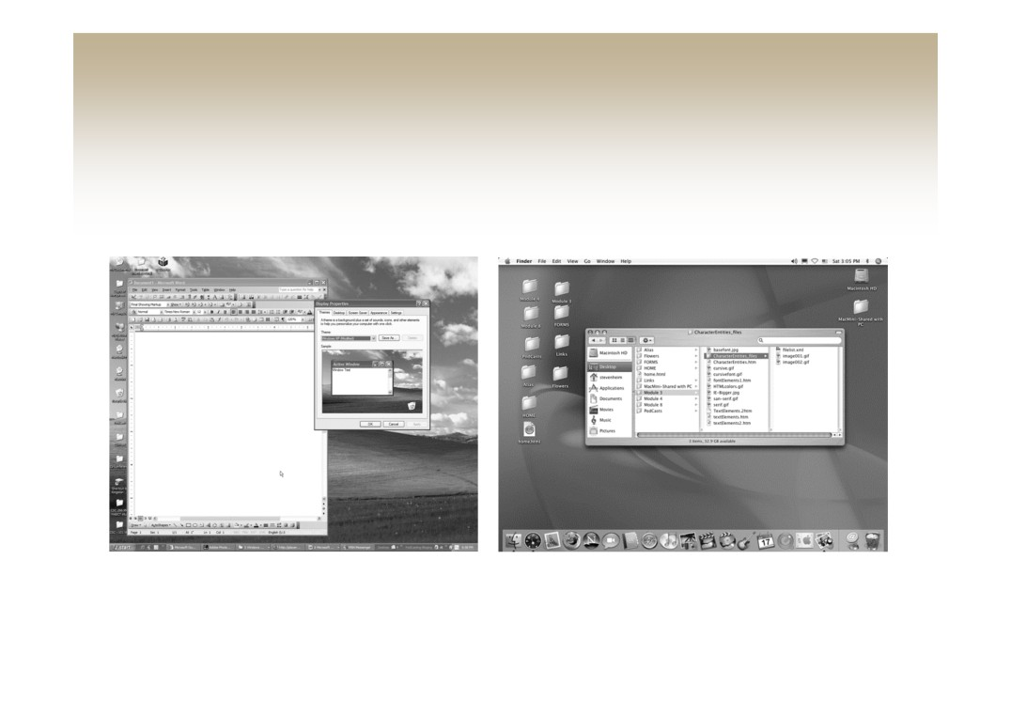
Interaction Styles - Metaphors
Microsoft Windows XP
Apple OS X

Slide 72
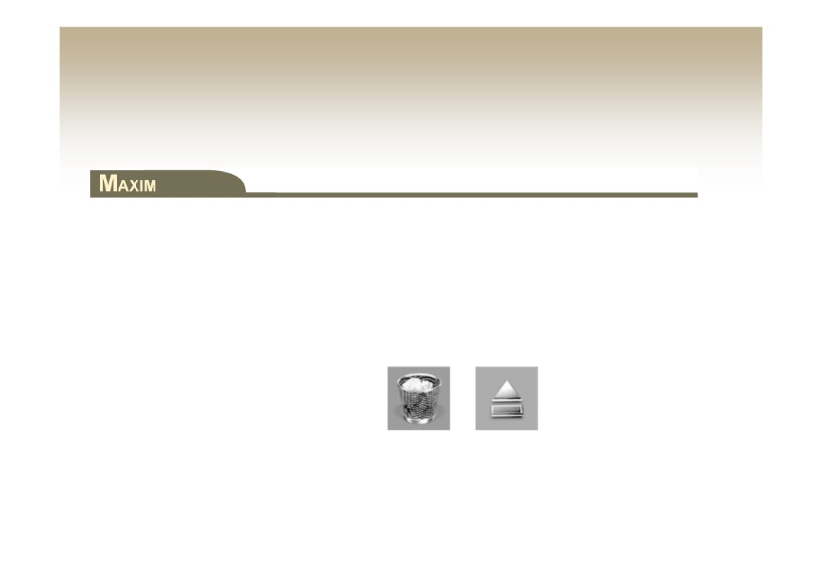
Interaction Styles - Metaphors
A metaphor’s function must be consistent with real-world
expectations
• Metaphors that do not behave the way people
expect will cause confusion and frustration
• Macintosh trashcan

Slide 73

Interaction Styles - Metaphors
Don’t force a metaphor
• Potential problems with metaphors
- Run out of metaphors
• Some virtual processes and objects have no real-world
counter parts
- Mixed metaphors
- Carry connotations and association

Slide 74
Interaction Styles - Web Navigation
• Two basic interaction styles
- Link-based navigation
• Sensitive to articulatory distance
• Ambiguous link labels increase the gulf of evaluation
- Search
• Sensitive to semantic distance
• Inadequate search engine algorithms increase the gulf of
execution
• Slight advantage in development of mental models

Slide 75
Interaction Styles - 3D Environments
• 3D interaction is natural in the real-world
• 3D environments are common in digital games
• Rich graphical 3D environment are processor
intensive

Slide 76
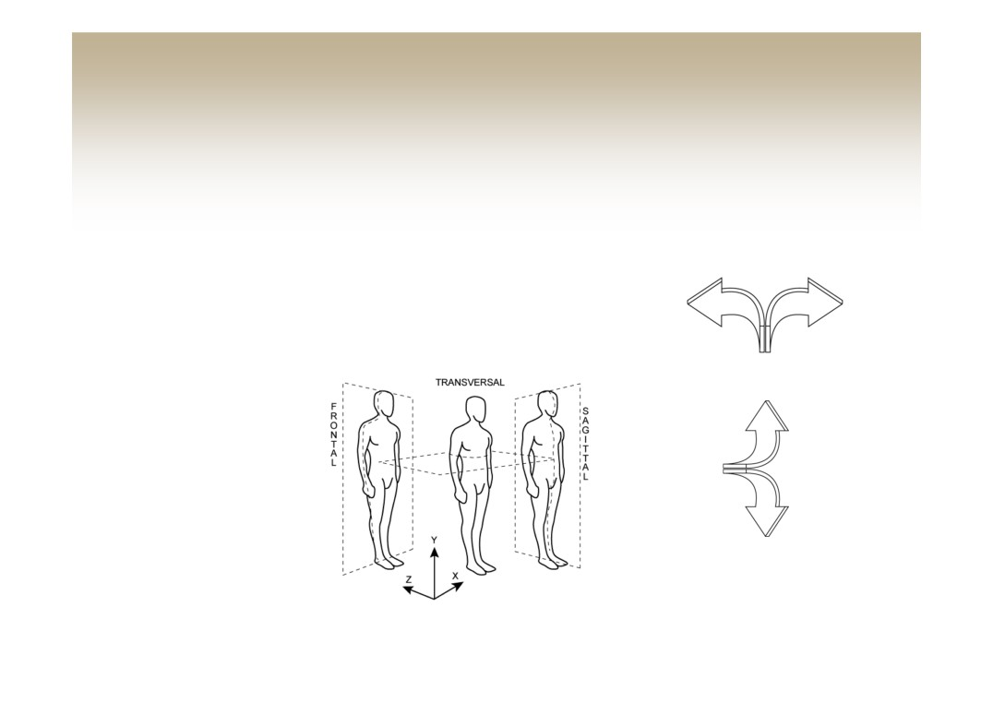
Interaction Styles - 3D Environments
•3D Navigation
- Involves two types of movement
• Translation - movement on a plane
• Rotation - movement around an axis
Yaw
Pitch

Slide 77

Interaction Styles - 3D Environments
• Web-based 3D
- Use vector-based graphics to decrease file size
- Virtual Reality Modeling Language (VRML)
• Uses polygons with parameters
- Transparency
- Texture maps
- shininess
- X3-D is XML based - Web3D.org
• Offers greater flexibility and control

Slide 78

Interaction Styles - 3D Environments
• Desktop 3D
- Current GUIs are predominantly 2D
- 3D environments presented on 2D screens are
difficult to navigate
Three-dimensional navigation can quickly become difficult and
confusing

Slide 79
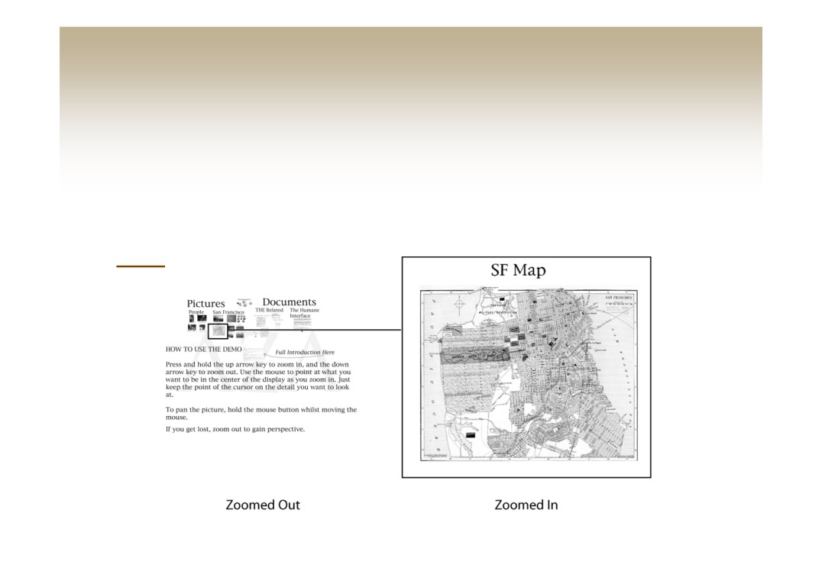
Interaction Styles - Zoomable Interface
• ZoomWorld (Jeff Raskin) is based on the
zooming interface paradigm (ZIP)
• ZoomWorld Demo

Slide 80

Interaction Styles - Zoomable Interface
Zoomable interfaces allow us to use our sense of relative positioning
• ZIP is based on landmarks and relative
positioning (organizational cues)
- Proportion
- Color
- Patterns
- Proximity
• Pad++: Zoomable User Interface (ZUI)

Slide 81
Interaction Styles - Natural Language
• Natural Language Interaction (NLI) - Interacting
with computers using everyday language
• Obstacles
- Language is ambiguous
- Meaning depends on context
• “Search results”
• “She said she did not know”
- Dependant on visual cues

Slide 82
Interaction Styles - Natural Language
• Applications for NLI
- Speech Input
• Hands-free operation
• Poor Lighting Situations
• Mobile Applications
• In the home
- Speech Output
• On-board navigational systems
Copyright © 2008 Pearson Education, Inc. Publishing as Pearson Addison-Wesley
1-59

Slide 83

Interaction Styles - Natural Language
• Two areas of development
- Speech recognition
- Semantics
• Grammar issues
• Vague meanings
• Contradictory statements
NLIs may require constant clarification of linguistic ambiguities

Slide 84
Interaction Styles - Natural Language
• Advantages of NLI:
- Ease of learning
- Low memory requirements
- Flexible interaction
- Low screen requirements
- Appropriate for beginners
• Disadvantages of NLI:
- Requires knowledge of the task domain
- May require tedious clarification dialogues
- Complex system development

